Slide 1
Introduction to pattern recognition
Ying shen
Sse, tongji university
Sep. 2016

Slide 2
Pattern recognition, machine learning, and data mining
Pattern recognition ≈ machine learning
PR
ML
Data Mining

Slide 3

How do you make a decision?
How to pick a “good” watermelon?
How do you know you have a cold?
Can you pick out the apple from bananas?
You are trained from the experience
You learn knowledge to make good decisions
Can a computer learn to make a decision like human?
How?
Pattern
Experience: data
Knowledge: model
Task:
Learn a model from data

Slide 4
What is machine learning?
One possible definition
a set of methods that can automatically detect patterns in data, and then use the uncovered patterns to predict future data, or to perform other kinds of decision making under uncertainty

Slide 5
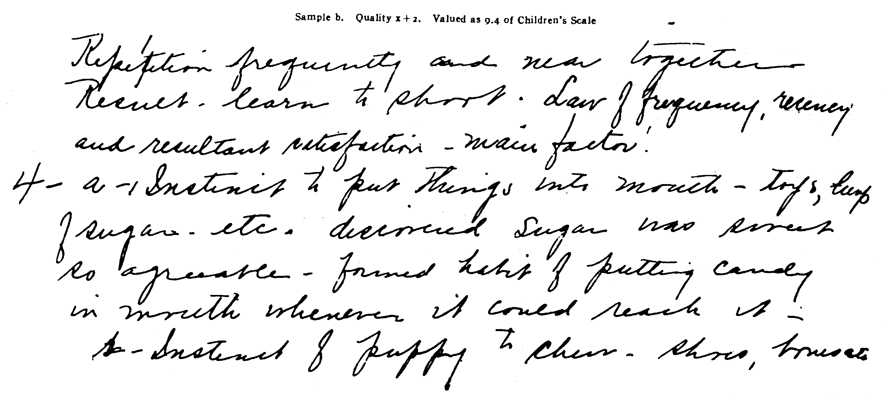
Example: detect patterns
How the temperature has been changing in the last 140 years?
Patterns
  We see repeated periods of fluctuation
  General trend is that temperatures are rising

Slide 6
How do we describe the pattern?
Build a model: fit the data with a polynomial function
The model is not accurate for individual years
But overall, the model captures the major trend

Slide 7
Predicting future
What is temperature of 2010?
This particular polynomial model is not exactly accurate for that specific year, but it is pretty close

Slide 8
What we have learned from this example?
Key ingredients in the machine learning task
  Data: collected from past observations (training data)
  Modeling: devised to capture the patterns in the data
    The model does not have to be true -- as long as it is close, it is useful
    We should tolerate randomness and mistakes -- many interesting things are stochastic by nature.
  Prediction: apply the model to forecast what is going to happen in future

Slide 9
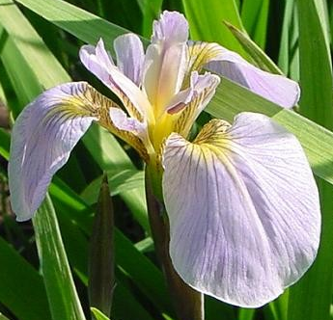
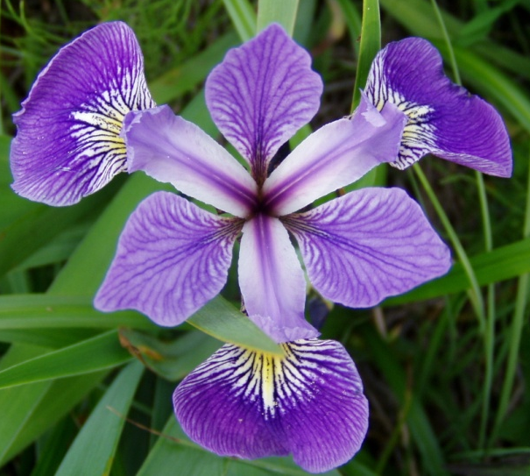
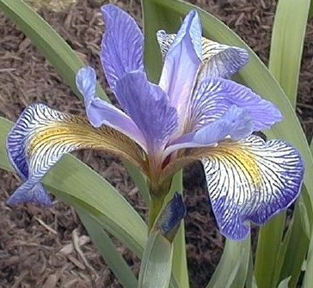
A rich history of applying statistical learning methods
Recognizing flowers (by R. Fisher, 1936)
petal
sepal
Iris Setosa
Iris Versicolor
Iris Virginica

Slide 10
Huge success 20 years ago
Recognizing handwritten zipcodes and checks (AT&T Labs, circalate 1990s)

Slide 11
More modern ones, in your social life
Recognizing your friends on Facebook

Slide 12
Learn your preferences
Recommending what you might like

Slide 13
Why is machine learning so hot?
Flood of data leads to several high-impact applications
Consumer applications:
  speech recognition, information retrieval and search, email and document classification, stock price prediction, object recognition, product recommendation, ...
  Highly desirable expertise from industry: Google, Facebook, Microsoft, Yahoo, Twitter, IBM, LinkedIn, Amazon, ...
Scientific applications:
  Biology and genetics: identify disease-causing genes and gene networks
  Climate science: predicting global warming trends
  Social science: social network analysis; social media analysis
  Business and finance: marketing, operation research
  Emerging ones: healthcare, energy,...

Slide 14
What is in machine learning?
Different flavors of learning problems
  Supervised learning: make prediction given labeled training observations, e.g., Spam detection, Iris
  Unsupervised learning: Discover hidden and latent patterns in data; data exploration, e.g., topic modelling in text data
  Many other paradigms
The focus and goal of this course
  Supervised learning
  Unsupervised learning
  Semi-supervise learning

Slide 15
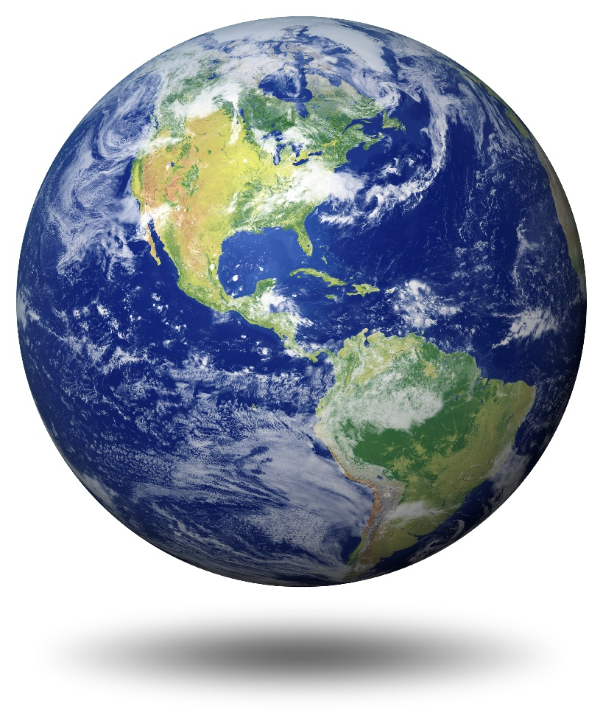
Let’s start!
Let’s begin to explore the PR world!

Slide 16

Some terms
label
attribute/feature
Iris dataset (from UCI machine learning repository)
attribute value
 | sepal length (in cm) | sepal width (in cm) | petal length (in cm) | petal width (in cm) | class
Sample 1 | 5.1 | 3.5 | 1.4 | 0.2 | Iris-setosa
Sample 2 | 4.9 | 3.0 | 1.4 | 0.2 | Iris-setosa
Sample 3 | 7.0 | 3.2 | 4.7 | 1.4 | Iris-versicolor
Sample 4 | 6.4 | 3.2 | 4.5 | 1.5 | Iris-versicolo
…
Sample 149 | 6.3 | 3.3 | 6.0 | 2.5 | Iris-virginica
Sample 150 | 5.8 | 2.7 | 5.1 | 1.9 | Iris-virginica
Iris setosa
山鸢尾
Iris versicolor
变色鸢尾
Iris virginica
Notes:
Iris setosa: 山鸢尾

Slide 17
Some terms
Sample/attribute space
Denote D={x₁,x₂,…,x_{m}} a dataset which contains m instances. Each instance has d features.
So x_{i} = (x_{i1} x_{i2} … x_{id}) is the i-th instance in the sample space X, x_{ij} is the value of x_{i} on j-th feature, and d is the dimension of sample x_{i}.

Slide 18
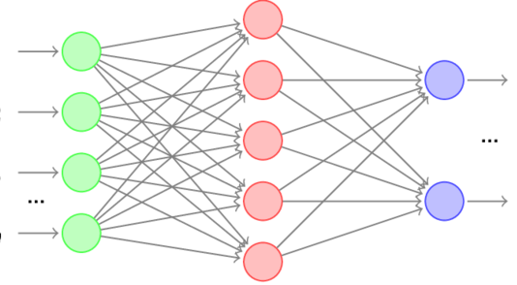
Some terms
The process of learning a model from a dataset is called learning/training process
Data used in the training process is called training data
Each sample in the training data is call training sample
All the training samples consist of a training set
learner
Training
Predicting
features
Output1
Training samples
…
Test samples
Output n

Slide 19
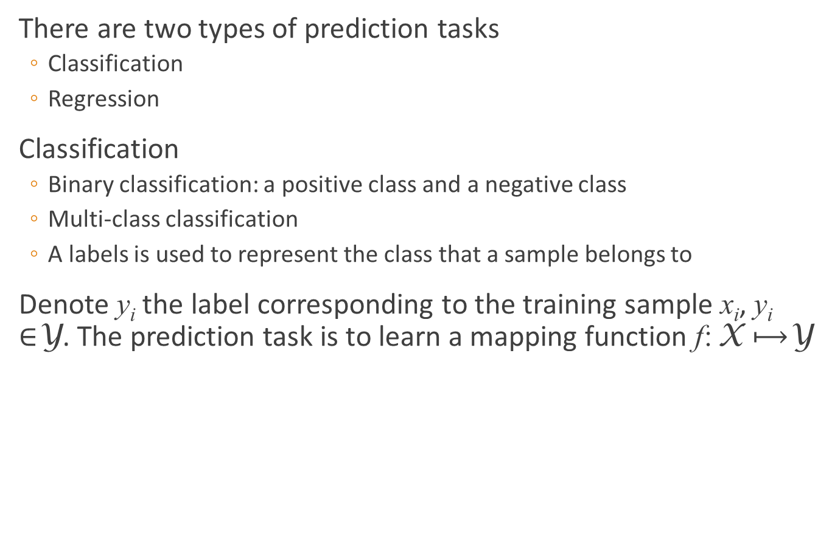
Some terms
There are two types of prediction tasks
  Classification
  Regression
Classification
  Binary classification: a positive class and a negative class
  Multi-class classification
  A labels is used to represent the class that a sample belongs to
Denote y_{i} the label corresponding to the training sample x_{i}, y_{i} $∈$Y. The prediction task is to learn a mapping function f: X $⟼$Y

Slide 20
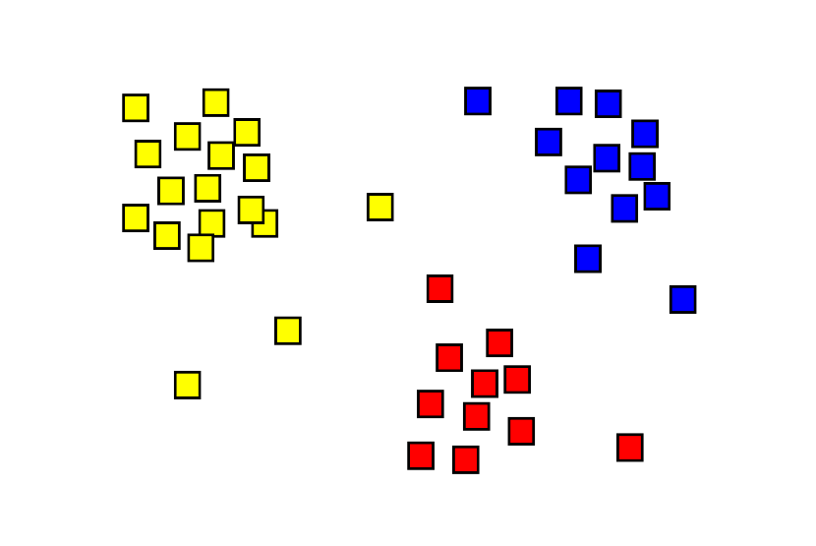
Some terms
We can also do clustering on data if labels are unknown
Learning tasks can be divided into
  Supervised learning (classification + regression)
  Unsupervised learning (clustering)
A cluster

Slide 21
Some terms
Generalization ability of a model
We assume that
  all the samples in a sample space obey a certain distribution (e.g. Gaussian distribution)
  and training samples are obtained by sampling from the space independently, i.e. training samples are independent and identically distributed (i.i.d)
The more samples are obtained, the more information about the distribution we can have, and the higher generalization ability of a learned model.

Slide 22
hypothesis space
Induction vs deduction
  Induction: special -> general
  Deduction: general -> special
Inductive learning
Hypothesis is a model or pattern learned from training data
编号 | 色泽 | 根蒂 | 敲声 | 好瓜
1 | 青绿 | 蜷缩 | 浊响 | 是
2 | 乌黑 | 蜷缩 | 浊响 | 是
3 | 青绿 | 硬挺 | 清脆 | 否
4 | 乌黑 | 稍蜷 | 沉闷 | 否

Slide 23
hypothesis space
The hypothesis space is much larger than the (training) sample space
There may exist more than one hypothesis corresponding to the same training set
These hypothesis forms a hypothesis set called version space
（色泽=*；根蒂=蜷缩；敲声=*）
（色泽=*；根蒂=*；敲声=浊响）
（色泽=*；根蒂=蜷缩；敲声=浊响）

Slide 24
Inductive bias
Given a new sample: （色泽=青绿；根蒂=蜷缩；敲声=沉闷）
Is it good or bad?
（色泽=*；根蒂=蜷缩；敲声=*）
（色泽=*；根蒂=*；敲声=浊响）
（色泽=*；根蒂=蜷缩；敲声=浊响）

Slide 25
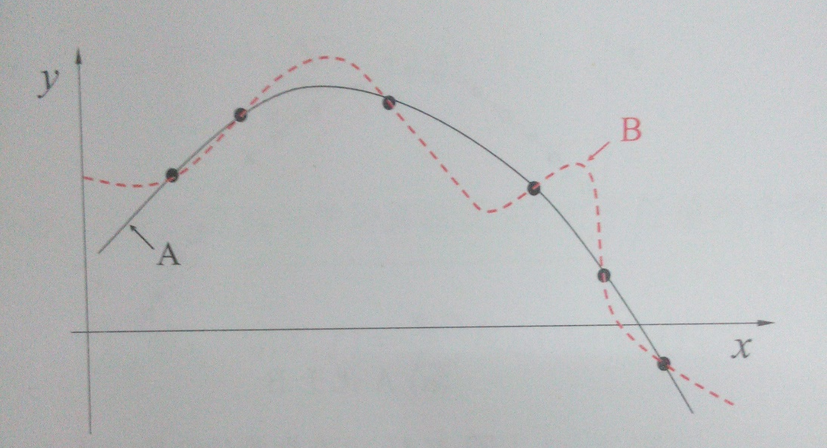
Inductive bias
Occam’s razor
Inductive bias is an assumption of “what is a good model”
（色泽=*；根蒂=蜷缩；敲声=浊响）
（色泽=*；根蒂=蜷缩；敲声=*）

Slide 26
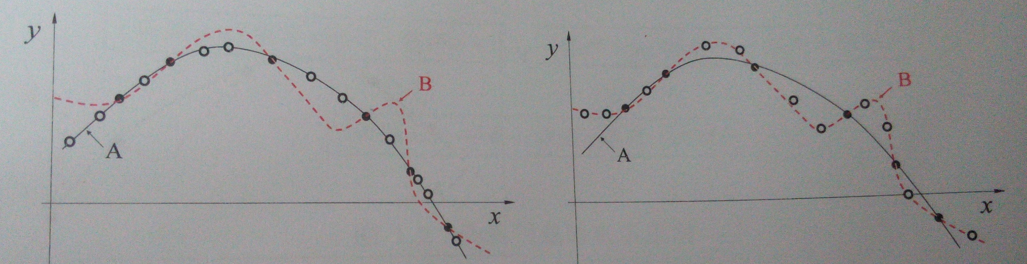
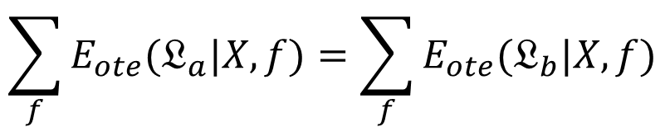
Inductive bias
No Free Lunch Theorem
$$\sum_{f}{E_{ote}(𝔏_{a}|X,f)}=\sum_{f}{E_{ote}(𝔏_{b}|X,f)}$$

